Slide 1
2014 Student Success Scorecard Report and District 2010-2016 Strategic Plan Metrics
Presented by
Mallory Newell
August 25, 2014

Slide 2
De Anza
Foothill
Notes:
Click: Even split between gender at DA and slightly higher rate of females at Foothill
Click: Age at De Anza is largely under 24 while 20-49 at Foothill, slightly older population.
Click: Asians at De Anza largest group followed by White and Hispanic.
Click: White at Foothill followed by Asian and Hispanic.

Slide 3
De Anza
68% Unprepared
Cohort Definition: Completion, Persistence and 30 Unit Completion
First time students with intent to complete.
Students who took a credit course for the first time, who completed 6 units in their first 3 years and attempted a Math or English course in their first 3 years.
Foothill
57% Unprepared
Notes:
Completion, Persistence, 30 unit cohorts.
De Anza cohort includes 3,034 students, 68% (2,066) are unprepared.
Foothill is 1,016, 57% (576) are unprepared.
Click: I wanted to highlight the ethnic groups where there is wider variance among the prepared and unprepared groups. These are for African American, Filipino, and Latino students who have higher rates of unprepared than prepared, and Asian who have higher rates of prepared students in the population. The first three groups are grouped throughout the rest of the presentation as the Targeted population to explore their success in greater detail.

Slide 4
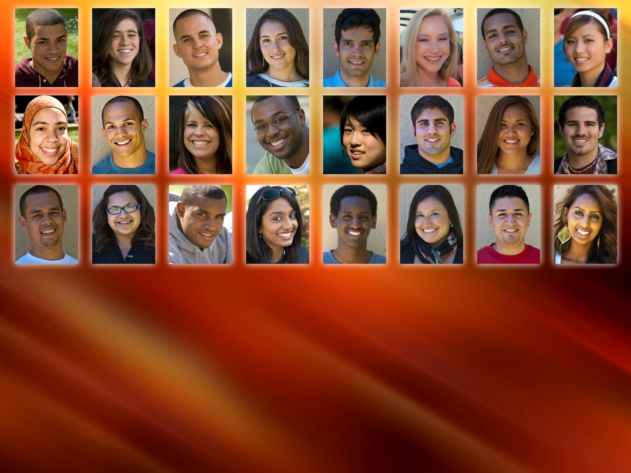
Student Stories

Slide 5
Completion – De Anza
De Anza Peer Group:
San Diego Mesa
Las Positas
Orange Coast
Ohlone
Diablo Valley
Santa Barbara City
L.A. Pierce
Moorpark
Cuesta
Golden West
Pasadena City
Palomar
Mira Costa
Fullerton
Folsom Lake
Skyline
Glendale
Cypress
Sierra
Prepared
Definition: Percentage of degree, certificate and/or transfer-seeking students starting first time, tracked for six years, who completed a degree, certificate or transfer-prepared.
District Metric: Each college will achieve 75% or the highest score within the peer group.
Not Targeted Ethnicity
Overall
Unprepared
Statewide - Overall
Targeted Ethnicity
Peer
Group
High
66.9%
Overall Completion Rate by Ethnicity
39% African American (41/105)
50% Filipino (93/185)
44% Latino (189/426)
Compared to
82% Asian (1,126/1,381)
61% White (391/641)
Prepared/Unprepared based on first course enrolled.
Targeted Ethnicity = African American, Latino/a, Filipino. Not Targeted = Native American, Asian, Pacific Islander, White, Unreported.
Notes:
Prepared/Unprepared based on lowest attempted Math or English course.
If lowest attempted Math course was one below or college level, then student is “prepared for college.”
If lowest attempted English course was college level, then student is “prepared for college.”
If lowest attempted Math or English was below college level (two levels below or more in Math), then student is “unprepared for college.”
If student attempts both Math and English, if lowest of either is below college level, then student is “unprepared for college.”
Transfer-Prepared” (60 UC/CSU transferrable units with GPA=>2.0)
International Students DA = 251
JCS = 72
District metric is 75% or peer high
Set Peer Group – Peer group the same for each metric

Slide 6
Completion – Foothill
Foothill Peer Group:
San Francisco City
Irvine Valley
Saddleback
Marin
San Diego Miramar
West Valley
San Mateo
Cañada
Prepared
Not Targeted Ethnicity
Overall
Unprepared
Statewide - Overall
Targeted Ethnicity
Overall Completion Rate by Ethnicity
40% African American (21/52)
62% Filipino (16/26)
38% Latino (56/149)
Peer
Group
High
64.3%
Compared to
85% Asian (224/263)
66% White (262/399)
Prepared/Unprepared based on first course enrolled.
Targeted Ethnicity = African American, Latino/a, Filipino. Not Targeted = Native American, Asian, Pacific Islander, White, Unreported.
Notes:
International Students FH = 72

Slide 7
Peer Group High
Not
Targeted
Overall
Prepared
Unprepared
Targeted
84%
67%
67%
74%
59%
45%
+6%
+3%
-3%
+4%
+5%
DA
48%
Completion
CA
+1%
81%
71%
64%
64%
52%
41%
+2%
+2%
+5%
+4%
+3%
FH
2014 Report Year
+/- between 2003-04 to 2007-08 cohorts

Slide 8
Persistence – De Anza
Statewide - Overall
Not Targeted Ethnicity
Definition: Percentage of degree, certificate and/or transfer-seeking first time students tracked for six years who enrolled in four consecutive terms.
District Metric: No gap between groups.
Overall
Unprepared
Prepared
Targeted Ethnicity
Peer
Group
High
83.1%
Overall Persistence Rate by Ethnicity
64% African American (67/105)
81% Filipino (149/185)
66% Latino (281/426)
Compared to
75% Asian (1,041/1,381)
68% White (434/641)
Persistence Gap (compared to White)
African Americans = 4%
Filipino = No gap
Latino = 2%
Prepared/Unprepared based on first course enrolled.
Targeted Ethnicity = African American, Latino/a, Filipino. Not Targeted = Native American, Asian, Pacific Islander, White, Unreported.
Notes:
District Metric: No gap between groups.

Slide 9
Persistence – Foothill
Statewide - Overall
Prepared
Overall
Unprepared
Not Targeted Ethnicity
Targeted Ethnicity
Overall Persistence Rate by Ethnicity
64% African American (33/52)
73% Filipino (19/26)
59% Latino (88/149)
Peer
Group
High
78.1%
Compared to
78% Asian (204/263)
69% White (274/399)
Persistence Gap:
African American = 5%
Filipino = No gap
Latino = 10%
Prepared/Unprepared based on first course enrolled.
Targeted Ethnicity = African American, Latino/a, Filipino. Not Targeted = Native American, Asian, Pacific Islander, White, Unreported.

Slide 10
30 Unit Completion – De Anza
Not Targeted Ethnicity
Unprepared
Prepared
Overall
Targeted Ethnicity
Definition: Percentage of degree, certificate and/or transfer-seeking first time students, tracked for six years who achieved at least 30 units.
Statewide - Overall
Overall 30 Unit Completion Rate by Ethnicity
70% African American (73/105)
85% Filipino (158/185)
67% Latino (285/426)
Peer
Group
High
78.1%
Compared to
82% Asian (1,133/1,381)
78% White (499/641)
Prepared/Unprepared based on first course enrolled.
Targeted Ethnicity = African American, Latino/a, Filipino. Not Targeted = Native American, Asian, Pacific Islander, White, Unreported.

Slide 11
30 Unit Completion – Foothill
Not Targeted Ethnicity
Overall
Unprepared
Prepared
Statewide - Overall
Targeted Ethnicity
30 Unit Completion Rate by Ethnicity
71% African American (37/52)
77% Filipino (20/26)
59% Latino (88/149)
Peer
Group
High
74.6%
Compared to
79% Asian (207/263)
74% White (294/399)
Prepared/Unprepared based on first course enrolled.
Targeted Ethnicity = African American, Latino/a, Filipino. Not Targeted = Native American, Asian, Pacific Islander, White, Unreported.

Slide 12
Basic Skills English – De Anza
Not Targeted Ethnicity
Definition: Percentage of students who started 1-4 levels below transfer level English tracked for six years, who complete college level English.
District Metric: Each college will achieve 85% or the highest score within the peer group.
Overall
Targeted Ethnicity
Peer
Group
High
72.1%
Statewide - Overall
Overall Rate by Ethnicity
51% African American (50/98)
75% Filipino (123/164)
57% Latino (214/377)
Compared to
84% Asian (632/757)
71% White (245/345)
Prepared/Unprepared based on first course enrolled.
Targeted Ethnicity = African American, Latino/a, Filipino. Not Targeted = Native American, Asian, Pacific Islander, White, Unreported.
Notes:
District Metric: 85% of the peer high.

Slide 13
Basic Skills English – Foothill
Not Targeted Ethnicity
Overall
Targeted Ethnicity
Statewide - Overall
Peer
Group
High
62.4%
Overall Rate by Ethnicity
52% African American (31/60)
32% Filipino (8/25)
48% Latino (84/177)
Compared to
70% Asian (56/80)
63% White (157/248)
Prepared/Unprepared based on first course enrolled.
Targeted Ethnicity = African American, Latino/a, Filipino. Not Targeted = Native American, Asian, Pacific Islander, White, Unreported.

Slide 14
Basic Skills Math – De Anza
Definition: Percentage of students who started 2-4 levels below transfer level math tracked for six years, who complete 1 level below college level math.
Not Targeted Ethnicity
Overall
Targeted Ethnicity
Overall Rate by Ethnicity
44% African American (57/129)
53% Filipino (101/190)
41% Latino (196/483)
Peer
Group
High
53.5%
Statewide - Overall
Compared to
69% Asian (317/462)
55% White (297/542)
Prepared/Unprepared based on first course enrolled.
Targeted Ethnicity = African American, Latino/a, Filipino. Not Targeted = Native American, Asian, Pacific Islander, White, Unreported.

Slide 15
Basic Skills Math – Foothill
Not Targeted Ethnicity
Overall
Targeted Ethnicity
Peer
Group
High
50%
Statewide - Overall
Overall Rate by Ethnicity
38% African American (18/47)
35% Filipino (7/20)
39% Latino (57/148)
Compared to
60% Asian (25/42)
60% White (141/237)
Prepared/Unprepared based on first course enrolled.
Targeted Ethnicity = African American, Latino/a, Filipino. Not Targeted = Native American, Asian, Pacific Islander, White, Unreported.
Notes:
The total includes all races.
The data includes both Math classes that are degree applicable and not applicable.
Students with African American and White races both have shown a significant progress (4-5% point increase) in completing their Math classes in 2007-08

Slide 16
Basic Skills ESL – De Anza
Definition: Percentage of students who started at any level below transfer level ESL tracked for six years, who complete ESL series or college level English.
Not Targeted Ethnicity
Overall Rate by Ethnicity
29% African American (7/24)
50% Filipino (5/10)
13% Latino (9/70)
Peer
Group
High
65.4%
Overall
Statewide - Overall
Targeted Ethnicity
Compared to
52% Asian (332/644)
36% White (37/104)
Prepared/Unprepared based on first course enrolled.
Targeted Ethnicity = African American, Latino/a, Filipino. Not Targeted = Native American, Asian, Pacific Islander, White, Unreported.
Notes:
International Students DA = 156

Slide 17
Basic Skills ESL – Foothill
Not Targeted Ethnicity
Overall
Overall Rate by Ethnicity
33% African American (<10)
0% Filipino (0)
16% Latino (18/114)
Statewide - Overall
Peer
Group
High
58.3%
Compared to
61% Asian (82/135)
46% White (27/59)
Targeted Ethnicity
Prepared/Unprepared based on first course enrolled.
Targeted Ethnicity = African American, Latino/a, Filipino. Not Targeted = Native American, Asian, Pacific Islander, White, Unreported
Notes:
International Students FH= 47

Slide 18
CTE Completion– De Anza
Definition: Students who complete a CTE course for the first time and complete more than 8 units in 3 years in a single discipline who, within 6 years, complete a degree, certificate or transfer-prepared.
District Metric: Each college will achieve 90% or the highest rate within the peer group.
Not Targeted Ethnicity
Statewide - Overall
Overall
Targeted Ethnicity
Peer
Group
High
68.8%
Overall Rate by Ethnicity
61% African American (77/126)
64% Filipino (93/146)
56% Latino (267/479)
Compared to
66% Asian (894/1,342)
57% White (459/803)
Prepared/Unprepared based on first course enrolled.
Targeted Ethnicity = African American, Latino/a, Filipino. Not Targeted = Native American, Asian, Pacific Islander, White, Unreported.
Notes:
District Metric: 90% or peer high.

Slide 19
CTE Completion– Foothill
Overall
Statewide - Overall
Not Targeted Ethnicity
Targeted Ethnicity
Overall CTE Completion Rate by Ethnicity
44% African American (27/61)
52% Filipino (33/63)
38% Latino (95/253)
Peer
Group
High
55.2%
Compared to
52% Asian (292/563)
41% White (342/835)
Prepared/Unprepared based on first course enrolled.
Targeted Ethnicity = African American, Latino/a, Filipino. Not Targeted = Native American, Asian, Pacific Islander, White, Unreported.

Slide 20
DA
FH

Slide 21
Course Completion – De Anza
14%
gap
4%
gap
11%
gap
7%
gap
7%
gap
Definition: Students who received a successful grade in any quarter within 2013-14.
District Metric: Each college will achieve less than a 5 percentage point difference between the rate of historically underserved groups and all other groups.
(5,566)
(65,748)
(9,155)
(30,731)
(623)
(849)
(29,774)
Decline to State not graphed.
Notes:
District Metric: Each college will achieve less than a 5 percentage point difference between the rate of historically under-served groups and all other groups.

Slide 22
Course Completion – Foothill
21%
gap
5%
gap
12%
gap
8%
gap
13%
gap
(3,163)
(21,552)
(3,737)
(13,608)
(474)
(921)
(24,824)
Decline to State not graphed.
Notes:
District Metric: Each college will achieve less than a 5 percentage point difference between the rate of historically under-served groups and all other groups.

Slide 23
High School Participation
Definition: Percentage of public high school graduates from the FHDA service area who enrolled at FHDA in the following fall quarter.
Service Area = Fremont Union, Mountain View-Los Altos and Palo Alto districts.
District Metric: The participation rate will increase to 30%.
Notes:
District Metric: The participation rate will increase to 30%.
14.8% district wide in fall 2013.

Slide 24
Questions or Comments
Notes:
Env Sustain Target .9
Balance Budget Target 1.0
2010-2011 ADOPTED BUDGET
Amended September 9, 2010
1. Ongoing Revenue / Ongoing Expense
Ongoing revenues and expenses are derived from the supplemental table “Changes in
Fund 14 Revenue and Expenses” in the adopted budget book. Budgeted general fund
revenues and expenses at the beginning of each fiscal year are used for ongoing
revenues and expenses.
An index composed of five factors evaluating energy use: reduction in energy
consumption, self-generated energy capacity, water usage, district vehicles on
alternative fuels, and greenhouse gas emissions.
The capacity use ratios measure utilization of space as calculated by comparing the
districts' assignable square feet available per student weekly contact hour generated in
that category of space (lecture, lab, etc) to the utilization standards set by the state (see
Title 5, Chapter 8 Section 57028). This metric is an index composed of nine types of
district spaces used for critical activities associated with providing educational services
for students, with utilization projected to FY 2016-2017.

