Slide 1
Program Review Tool – Tracking a Cohort

Slide 2
Capabilities: (by year and term)
Enrollment trends
Faculty workload
Course success
Course success for targeted groups
Enrollment distribution by student demographics
Success rates by gender, age, and ethnicity

Slide 3
Disaggregation – Course Level
College
Division
Department
Course
Subject
Online status

Slide 4
Disaggregation – Student Level
Demographic characteristics (age, ethnicity, etc.)
New or continuing students
Accounting method (daily census, independent lab, etc.)
Special student populations (DSPS, Foster Youth, etc.)
Participation in special programs (VIDA, FYE, Umoja, etc.)
Custom created cohorts can be uploaded and tracked through the Manage Cohorts feature.

Slide 5
A Visual Guide Through the Program Review Tool

Slide 6
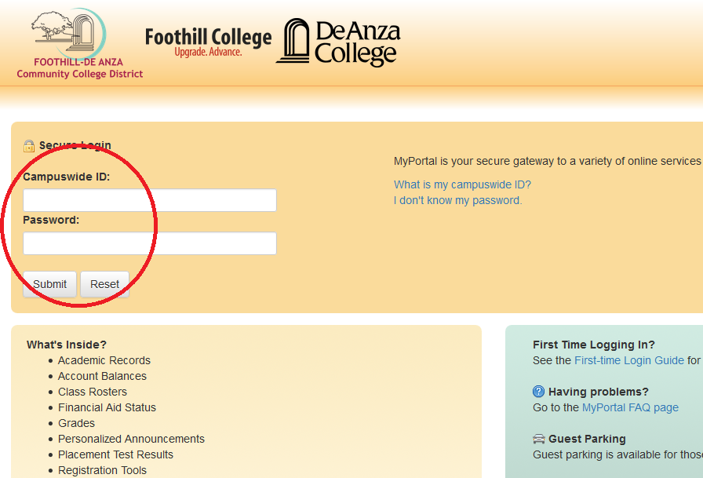
Access

Slide 7
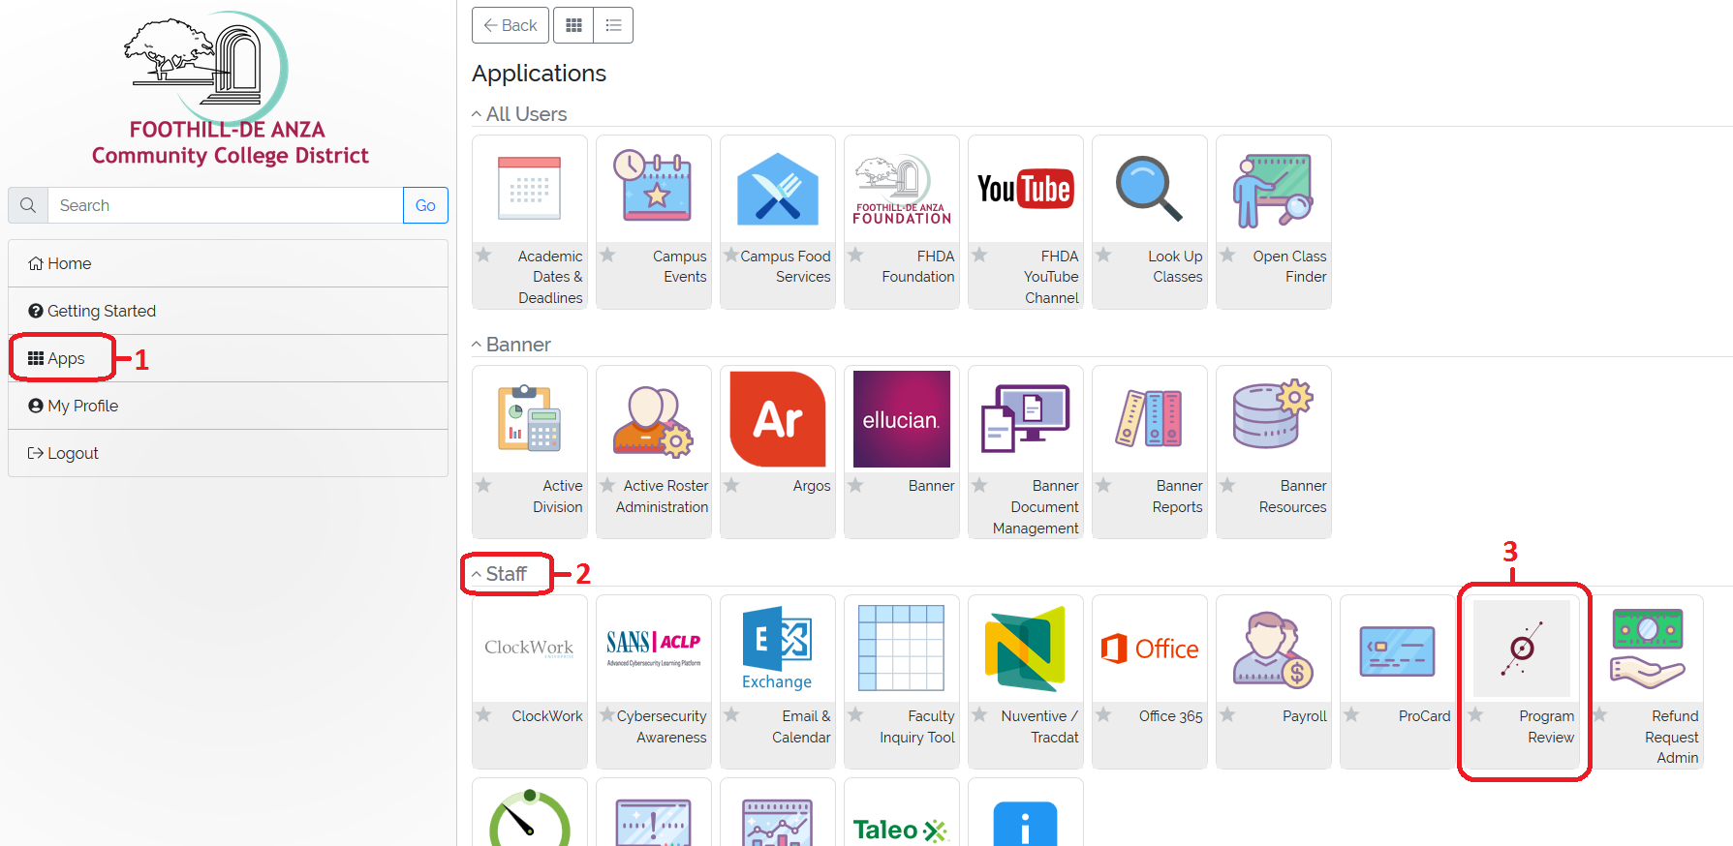
Access

Slide 8
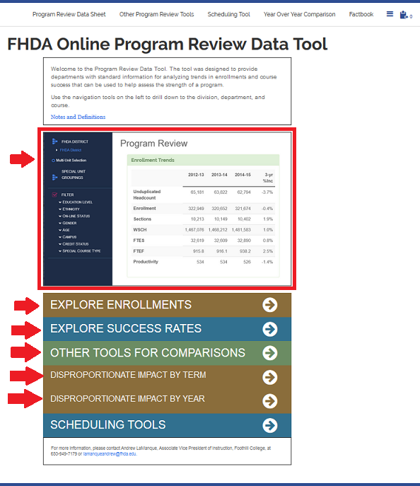
Home Page

Slide 9
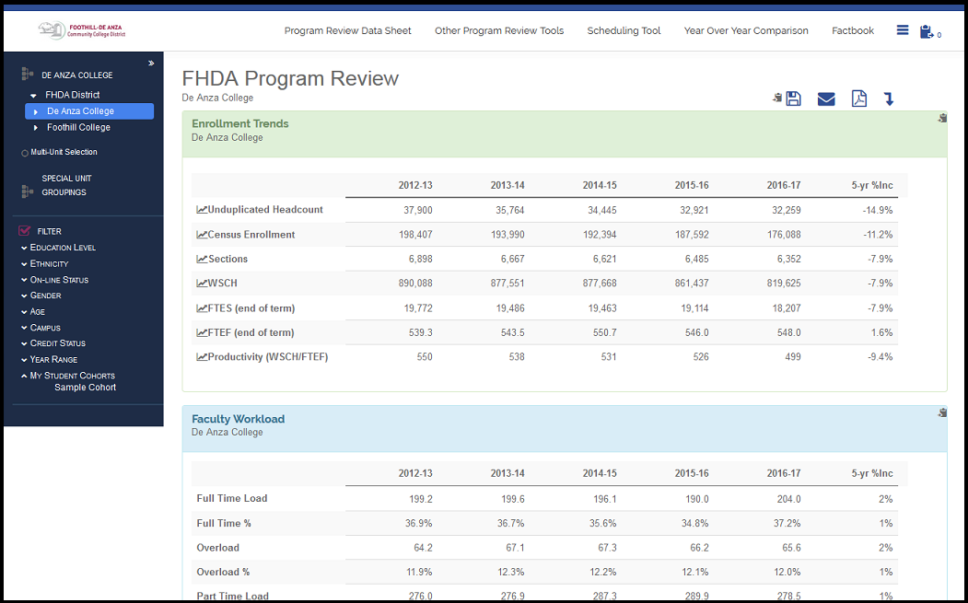
Program Review

Slide 10
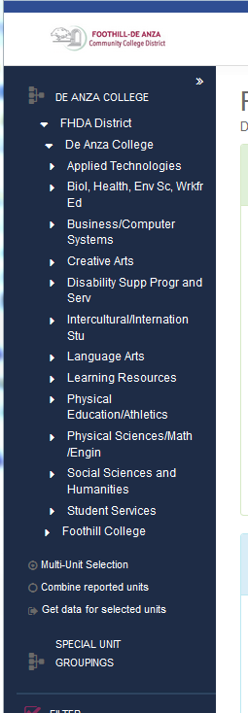
Course Selection

Slide 11
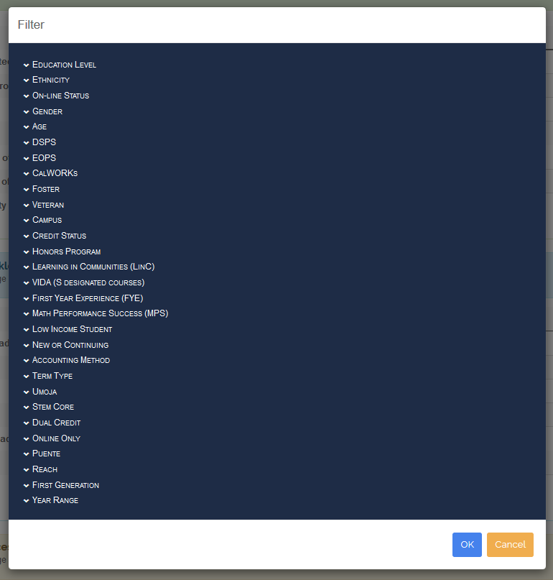
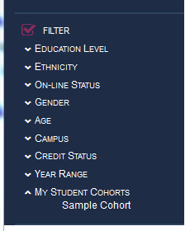
Filters

Slide 12
Cohort Tracker Tool
Gives the ability to upload multiple student cohort groups to track progress.
Accepts spreadsheets with student IDs only when the file is in txt. or CSV format. If using Excel on Mac computers, try the following formats:
MS-DOS Comma Separate. (CSV)
Windows Formatted Text. (txt)
Not a standard feature on the Program Review tool.
If you would like access, please send an email with your employee ID number to sabawiola@fhda.edu

Slide 13
Cohort Tracker Tool

Slide 14
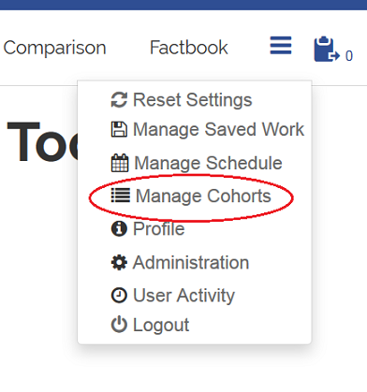
Cohort Tracker Tool

Slide 15
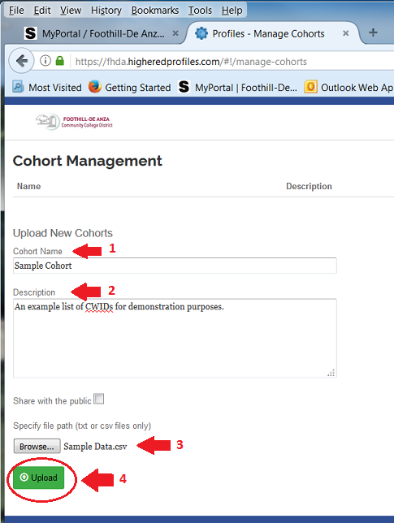
Cohort Tracker Tool

Slide 16
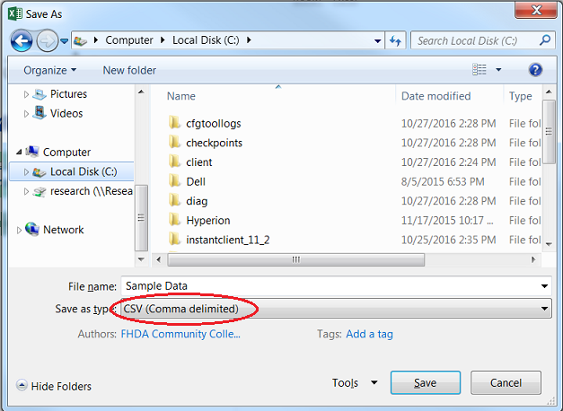
Cohort Tracker Tool

Slide 17
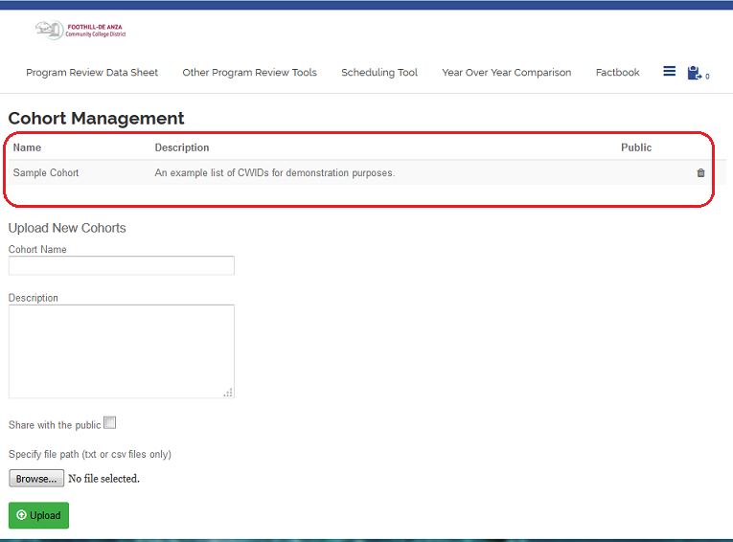
Cohort Tracker Tool
Note: Click on the cohort after uploading to make sure that the students’ IDs were found

Slide 18
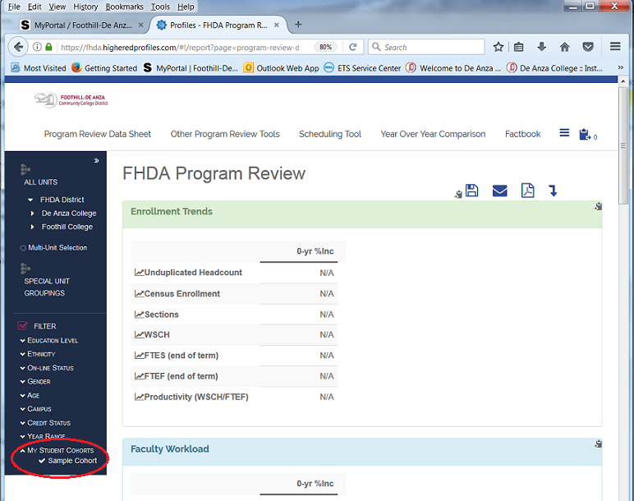
Cohort Tracker Tool

Slide 19
Questions/Comments
Ola Sabawi
sabawiola@fhda.edu
Ext. 5707

